Slide 1

STUDENT ORGANIZATION
ACCOUNTS
A Guide for Texas State Student Organizations

Slide 2


About UFCU
UFCU offers all the banking services you expect, but as a not-for-profit, member-owned cooperative, we don’t have shareholders – we answer to members.
Anyone can become a member
Your financial success matters
We’re with you for the long term
You can trust us to put you first
.
Notes:
“Membership” is open to anyone. And because we’re member-owned, members reap the benefits: lower interest rates on your loans and higher rates of return on your investments.
We are known for going above-and-beyond for our members with our legendary service and our guidance to help you meet your goals.
Many members join us as students then stay on for their auto loan, their mortgage, their investments, and more. We’re here for good.
For more than 85 years, UFCU has served our members and our community.

Slide 3
Step by Step
1
Create your Student Org and select your officers
2
Complete Meeting Minutes and any required TXST Student Org Requirements
3
File for Student Org Employee Identification number (EIN)
4
Open a Student Org Account
5
Create a Student Org Budget
Notes:
First we’re going to go over why it’s so important to make a budget and define it a bit more, especially in terms of a club or organization
Next we’ll talk about that critical first step towards making an annual budget and why it might be the hardest part
Then we’ll go into making the budget and how it works
We’ll show you a sample organizational budget and walk you through a worksheet
Also, we’ve got some money-saving and budgeting tips to share from years of experience
And then we can open it up to more questions. But also, feel free to ask any questions along the way

Slide 4


Define your Org and Select your officers
Write your plans down
Select your founding officers
Finalize your Org by creating meeting minutes
Sign your meeting minutes
Schedule meeting to define your Student Org

Slide 5
What are
Meeting Minutes?
Include who was present, what was discussed, and what decisions were made
Attendees can use minutes to recall what was discussed and what action items were assigned
Clear minutes promote transparency within an organization
a written record of what happens during a meeting

Slide 6


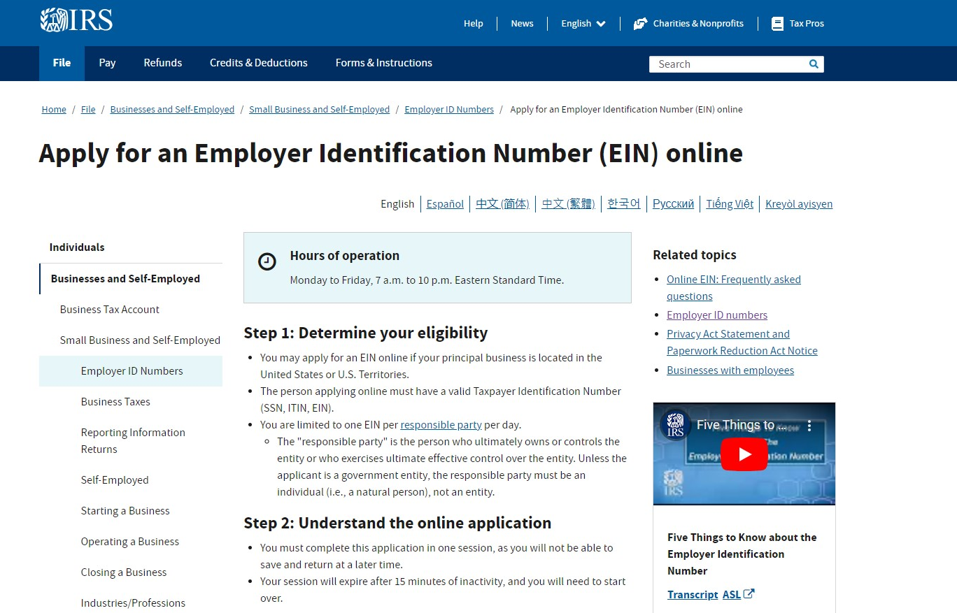
Filing for an EIN
Employee Identification Number
www.irs.gov
(Search EIN)
Notes:
Intro/Blank

Slide 7


What is a budget?
A listing of the dollars you expect to come in and the dollars you expect to spend
A financial plan for your year
Protection from risk and loss
A way to hold your business accountable
A visual expression of how your student org uses money to accomplish its goals
Notes:
First let’s talk about what a budget is – and is not.
A budget is an estimate of income and expenditure for a set period of time. Having an idea of how funds will be spent can keep the business out of financially risky situations.
But more importantly – a budget is a visual expression of the goals you and your business have. Whatever you want to accomplish, chances are it will take money. So it’s really important to make sure you have the money to meet your goals.

Slide 8

Why make a budget?
Can help you process how your student org can succeed
Can help make your goals more concrete and attainable
Can help you be more mindful of each area of your student org
Can help you put values on every element of your school year
Notes:
That’s why starting the budget process actually doesn’t begin with numbers at all.
It begins with a discussion about what you want to accomplish. Then assigning a monetary value to those things.
For example, you might say your biggest goal is to locate areas where you can cut expenses to build your business savings.
A budget allows you to track your income and expenses that are currently being paid out to to help find areas to adjust or cut to meet that goal.

Slide 9
Basics for making a budget
1. Identify your yearly goals
2. List predicted income and expenses and put into categories
3. Track incomes and expenses throughout the year
Notes:
When making a budget, again you don’t need Quickbooks or really any complicated platform at all. You can use Google Sheets or Microsoft Excel to make it pretty simple.
Again, first you’re going to need your goals and your organization’s plans for the year.
Then you’ll think through income and expenses. And it doesn’t matter which you start with because you’ll be going back and forth between them.
And then, you’re just going to have to track them. And again, you can use a pretty simple spreadsheet for all of this.

Slide 10



Let’s Get Started!
Scan QR Code
Download Google Sheets App
Download or create a copy of the worksheet
Access your banking information if possible
Notes:
Now that we’ve talked about creating goals and a budget for the year, let’s use some examples to see how that might work.

Slide 11

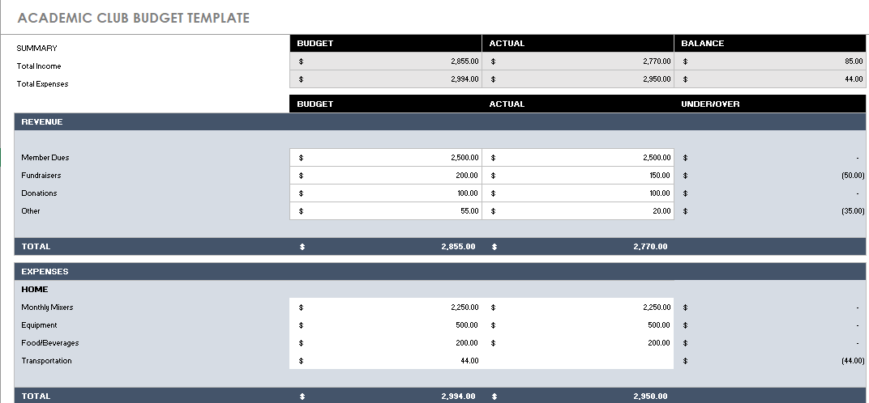
Notes:
Intro/Blank

Slide 12

Selecting a business structure
Speak to a Financial Professional to Assist in Opening the correct account

Slide 13
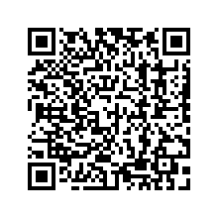
Questions?
Meet with a Campus Ambassador

Slide 14

Thank you!

